Slide 1
Using Generate and Calculate to create the item call number: a comparative study
Yoel Kortick
Senior Librarian

Slide 2
  Introduction
  Generate Call Number
  Calculate Call Number
  Table summary

Slide 3

Introduction

Slide 4
Introduction
In addition to this presentation see also “Generate” and “Calculate” at Managing Physical Resources.
The “Generate” and “Calculate” are options for creating an item call number.
In this presentation we will show how each option works and compare the two. In this manner each institution can decide which method is most appropriate.
First we will present three main differences between the two options, then we will show them live.

Slide 5
Introduction – Main difference 1 of 3
“Generate” requires changing parameter item_call_numbers_generate_enable to true and also setting up accession number sequences.
“Calculate” requires informing Ex Libris support that you want to use it and Ex Libris will enable it.

Slide 6
Introduction – Main difference 2 of 3
“Generate” creates a controlled set of item call numbers, as it is only possible to use call number prefixes which are defined as part of accession number sequences.
  It is based on the accession number sequence of the prefix
“Calculate” does not require that a specific value be entered as a call number prefix. Any value can be used, and if it does not yet exist it will begin counting (create new sequence) at “1”.
  It is based on existing call numbers

Slide 7
Introduction – Main difference 3 of 3
“Generate” uses accession number sequences and can therefore be defined on the level of the institution, the library, or the library and location.
“Calculate” by default works on the level of a library. If the same prefix is used in two different libraries then the counting (sequence) of each library will be different.

Slide 8


Generate Call Number

Slide 9
Generate Call Number
In order for the “Generate Call Number” option to appear in the physical item editor the institution must set the parameter item_call_numbers_generate_enable to true.
This parameter is available at “Configuration > Resources > General > Other Settings”.

Slide 10
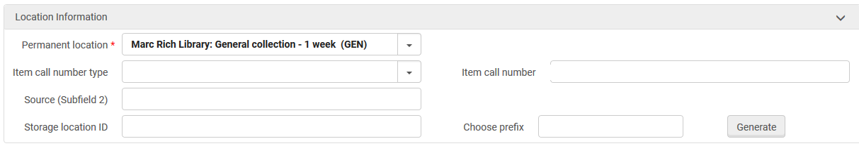
Generate Call Number
item_call_numbers_generate_enable = true
Now we see the “Generate” button

Slide 11
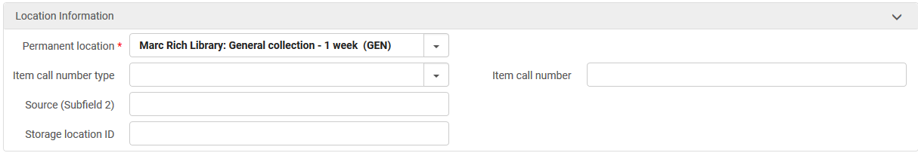
Generate Call Number
item_call_numbers_generate_enable = false
Now we do not see the “Generate” button

Slide 12
Generate Call Number
When item_call_numbers_generate_enable = true and “Generate” is clicked then a call number is generated. When the item is saved the call number will appear in the “Item Call Number” field.
The generated item call number is based on the accession number sequence of the prefix entered in the “Prefix” field of the physical item editor.

Slide 13
Generate Call Number
Let’s see this by way of an example (see Configuring Accession Numbers for more information)
At “Configuration > Resources > General > Accession Number” we see that we have two sequences: “Compactus” with next sequence “3” and “Reading Room” with next sequence “2”.
Neither sequence uses a library or location and thus will apply for items in any library or location (meaning “the entire institution”).
Both sequences uses method “prefSeq” which means that the call number will consist of the prefix and then the sequence number

Slide 14
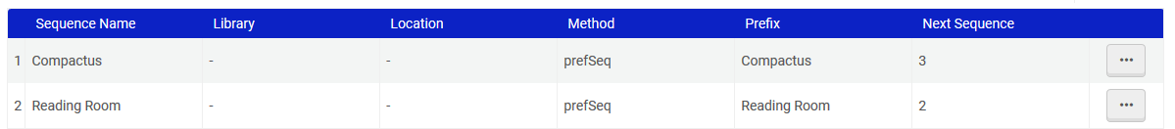
Generate Call Number
Both sequences uses method “prefSeq” which means that the call number will consist of the prefix and then the sequence number
Neither sequence uses a library or location and thus will apply for items in any library or location.

Slide 15
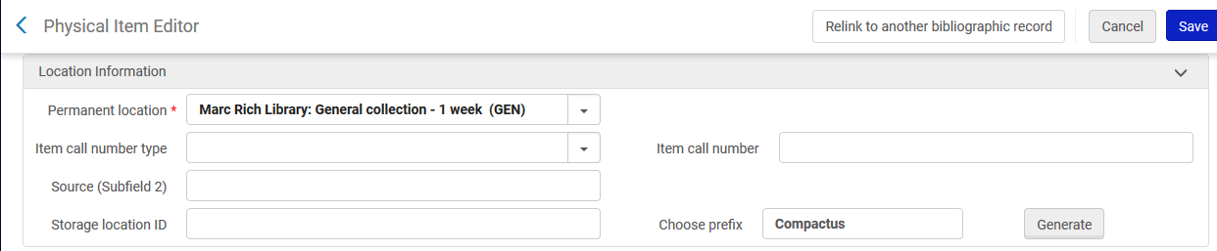
Generate Call Number
Here we have entered “Compactus” in the “Choose prefix” field and now we will click “Generate”

Slide 16
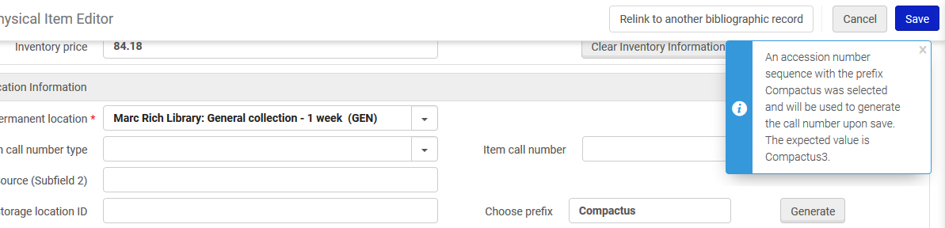
Generate Call Number
The staff user is informed that upon save a call number of “Compactus3” will be created. This is a combination of the prefix and the sequence.

Slide 17
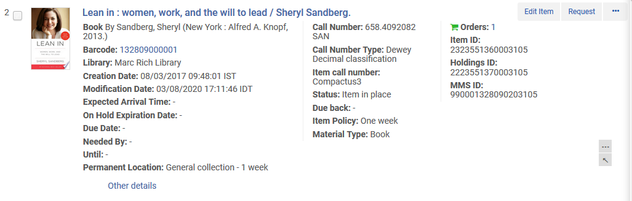
Generate Call Number
The item call number was created

Slide 18
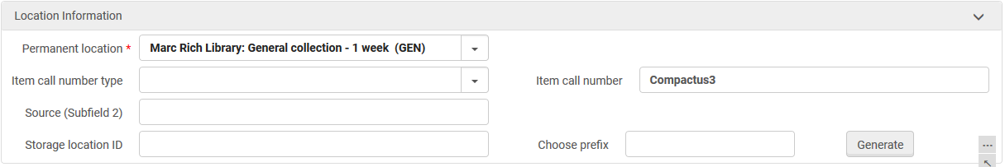
Generate Call Number
The item call number was created

Slide 19
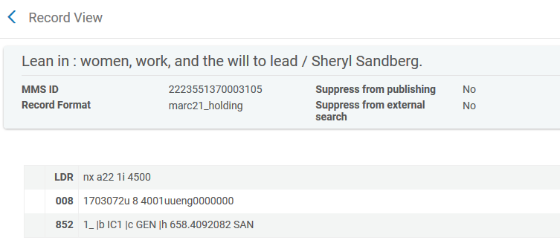
Generate Call Number
Note that the item call number is not part of the holdings record.

Slide 20
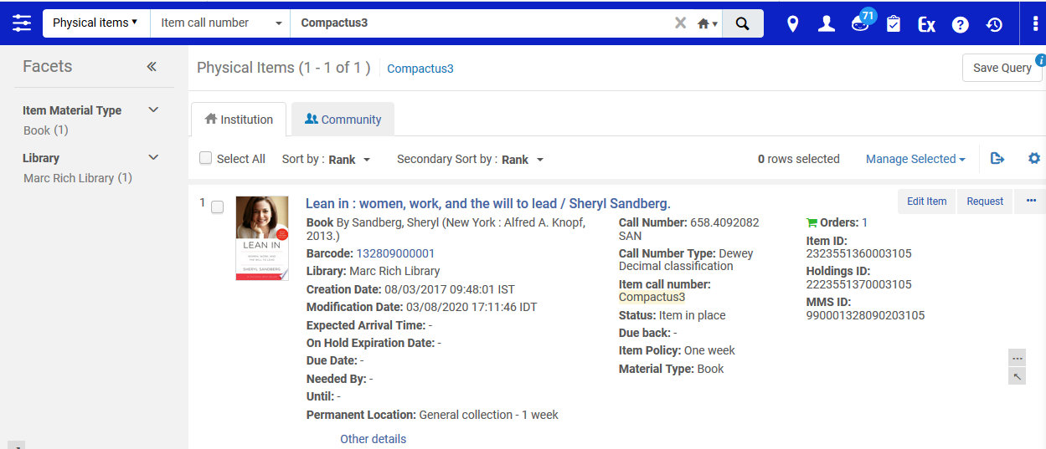
Generate Call Number
The item call number can be searched

Slide 21

Calculate Call Number

Slide 22
Calculate Call Number
In order for the “Calculate Call Number” option to appear in the physical item editor the institution must request that Ex Libris enable the option.

Slide 23
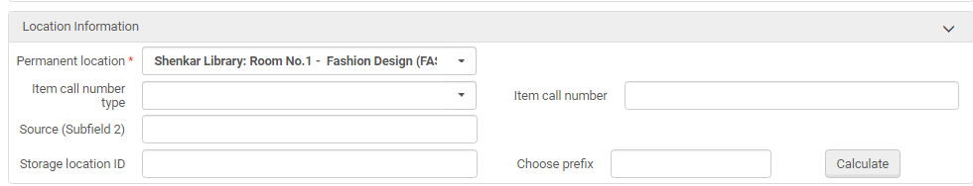
Calculate Call Number
Here the “Calculate Call Number” option appears in the physical item editor after the institution requested that Ex Libris enable the option.

Slide 24
Calculate Call Number
When “Calculate Call Number” is enabled and “Calculate” is clicked then an item-level call number is created.
When the item is saved the call number will appear in the “Item Call Number” field.
The generated item-level call number is based on existing call numbers in the Alma repository.

Slide 25
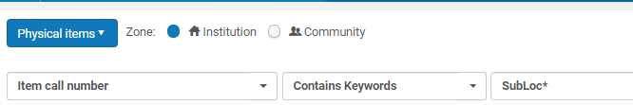
Calculate Call Number
For example, in our repository, in the library where we will not create a new item call number, we already have item call numbers “SubLoc1”, “SubLoc2” and “SubLoc3”

Slide 26
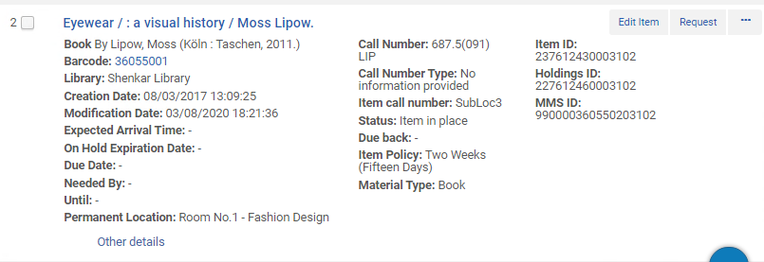
Calculate Call Number
Here is the item with item call number “SubLoc3”

Slide 27
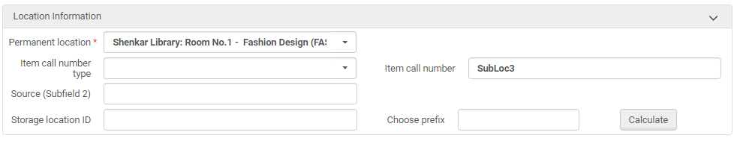
Calculate Call Number
Here is the item with item call number “SubLoc3”

Slide 28
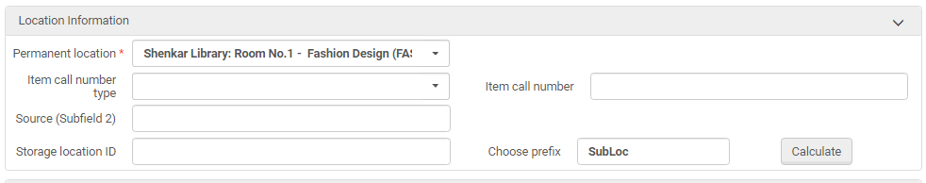
Calculate Call Number
Now we will choose prefix “SubLoc” in the physical item editor and choose “Calculate”. The system will see that there is already item call number “SubLoc1”, “SubLoc2” and “SubLoc3” and therefore create “SubLoc4”.

Slide 29
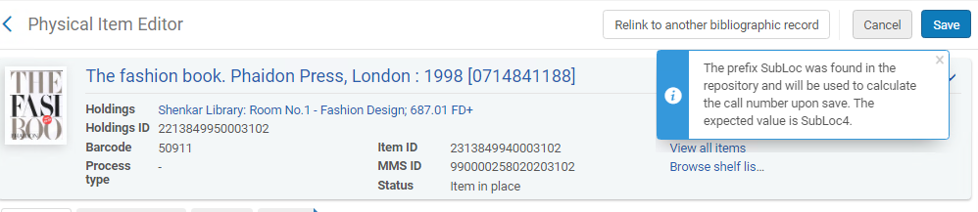
Calculate Call Number
The staff user is informed that upon save a call number of “SubLoc4” will be created. This is the next available number after prefix “SubLoc”

Slide 30
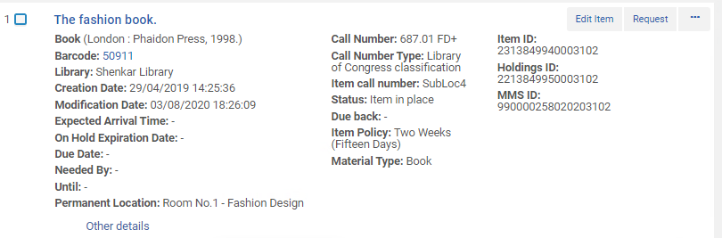
Calculate Call Number
The item call number was created

Slide 31
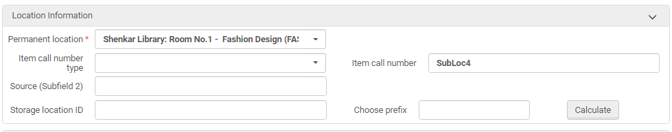
Calculate Call Number
The item call number was created

Slide 32
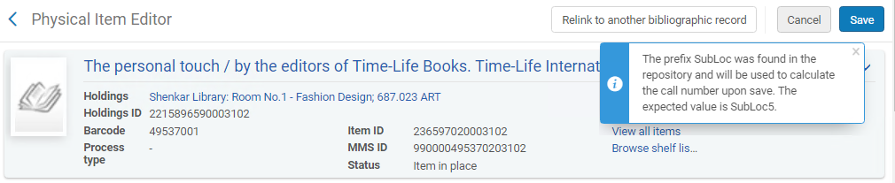
Calculate Call Number
The next time “SubLoc” is used as a prefix for an item in the same library and “Calculate” is clicked the item call number which is generated will be “SubLoc5”

Slide 33
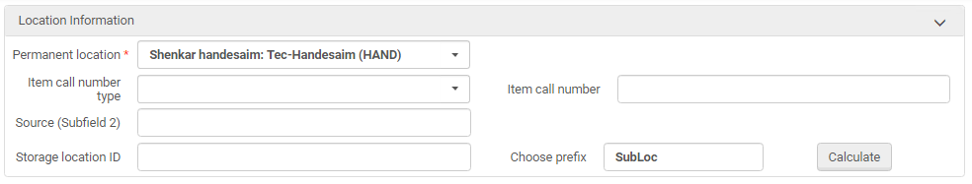
Calculate Call Number
But if “SubLoc” is used as a prefix for an item in a different library and “Calculate” is clicked the item call number which is generated will be according to the prefix in that library
Different library than we have been calculating in until now

Slide 34
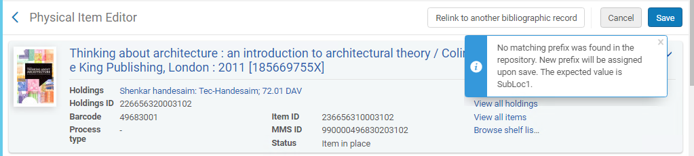
Calculate Call Number
Here in a different library of the same institution it will start with “SubLoc1” because this is the first time an item call number will have the prefix “SubLoc”

Slide 35

Table summary

Slide 36
Table summary
Generate | Calculate
Can be based on institution, library, or location | Based on library
Created as result of accession number configuration | Created as a result of existing call numbers
Requires configuration setup | Requires only telling Ex Libris you want to use it.
Will create a call number only if prefix is defined in accession number | Will always create a call number regardless of whether the prefix already exists or not
Staff user must enter the prefix and click “Generate” | Staff user must enter the prefix and click “Calculate”

Slide 37
xxx@exlibrisgroup.com

